Slide 1
CHAPTER 13 QUALITATIVE DATA ANALYSIS

Slide 2
Chapter Outline
Introduction
Linking Theory and Analysis
Qualitative Data Processing
Computer Programs for Qualitative Data
The Qualitative Analysis of Quantitative Data
Evaluating the Quality of Qualitative Research
Ethics and Qualitative Data Analysis
Chapter Summary
Questions

Slide 3
Linking Theory and Analysis (slide 1 of 5)
Qualitative analysis – The non-numerical examination and interpretation of observations, for the purpose of discovering underlying meanings and patterns of relationship.

Slide 4
Linking Theory and Analysis (slide 2 of 5)
Discovering Patterns in Qualitative Data
Frequencies
Magnitudes
Structures
Processes
Causes
Consequences

Slide 5
Linking Theory and Analysis (slide 3 of 5)
Cross-case analysis –involves an examination of more than one case; looks for patterns occurring across several observations. Variable- or case-oriented
Variable-oriented analysis – An analysis that describes and/or explains a particular variable.
Case-oriented analysis – An analysis that aims to understand a particular case or several cases by looking closely at the details of each.

Slide 6
Linking Theory and Analysis (slide 4 of 5)
Grounded Theory – Inductive approach to research in which theories are generated solely from an examination of data rather than being derived deductively.
Constant Comparative Method – A component of Grounded Theory in which observations are compared with one another and with the evolving inductive theory.

Slide 7
Linking Theory and Analysis (slide 5 of 5)
Four Stages of Constant Comparative Method (Glaser and Strauss):
Comparing incident application to each category
Integrating categories and their properties
Delimiting the theory
Writing theory

Slide 8
Linking Theory and Analysis (slide 1 of 3)
Semiotics – The study of signs and the meanings associated with them, “the science of signs.”
What is the meaning of:
…a blue ribbon?
…”say cheese”?
…a cross?
…a ghost emoji 👻👻👻

Slide 9
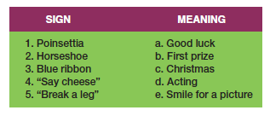
Figure 13-1
Matching Signs and Their Meanings

Slide 10
Linking Theory and Analysis (slide 2 of 3)
Conversation Analysis – A meticulous analysis of the details of conversation, based on a complete transcript that includes pauses, breaks, etc.

Slide 11
Linking Theory and Analysis (slide 3 of 3)
Fundamental Assumptions
Conversation is a socially constructed activity.
Conversations must be understood contextually.
Conversational analysis aims to understand the structure and meaning of conversation through excruciatingly accurate transcripts of conversations.

Slide 12
Qualitative Data Processing (slide 1 of 3)
Coding – Classifying or categorizing individual pieces of data, coupled with some kind of retrieval system.
Coding Units

Slide 13
Qualitative Data Processing (slide 2 of 3)
Creating Codes
Open Coding
the initial classification and labeling of concepts in qualitative data analysis.
a reanalysis of the results, aimed at identifying the important, general concepts.
Identify the central concept that organizes the other concepts.

Slide 14
Qualitative Data Processing (slide 3 of 3)
Memoing – Writing memos that become part of the data for analysis. Memos can describe and define concepts, deal with methodologies issues, or offer initial theoretical formulations.
Code Notes
Theoretical Notes
Operational Notes
Concept Mapping – The graphic display of concepts and their interrelations, useful in the formulation of theory.

Slide 15
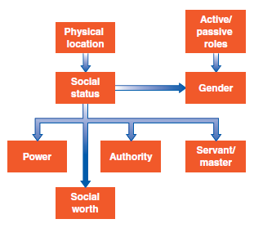
Figure 13-3
An Example of Concept Mapping

Slide 16
Computer Programs for Qualitative Data
QDA Programs:
Atlas.ti 
Dedoose 

Slide 17
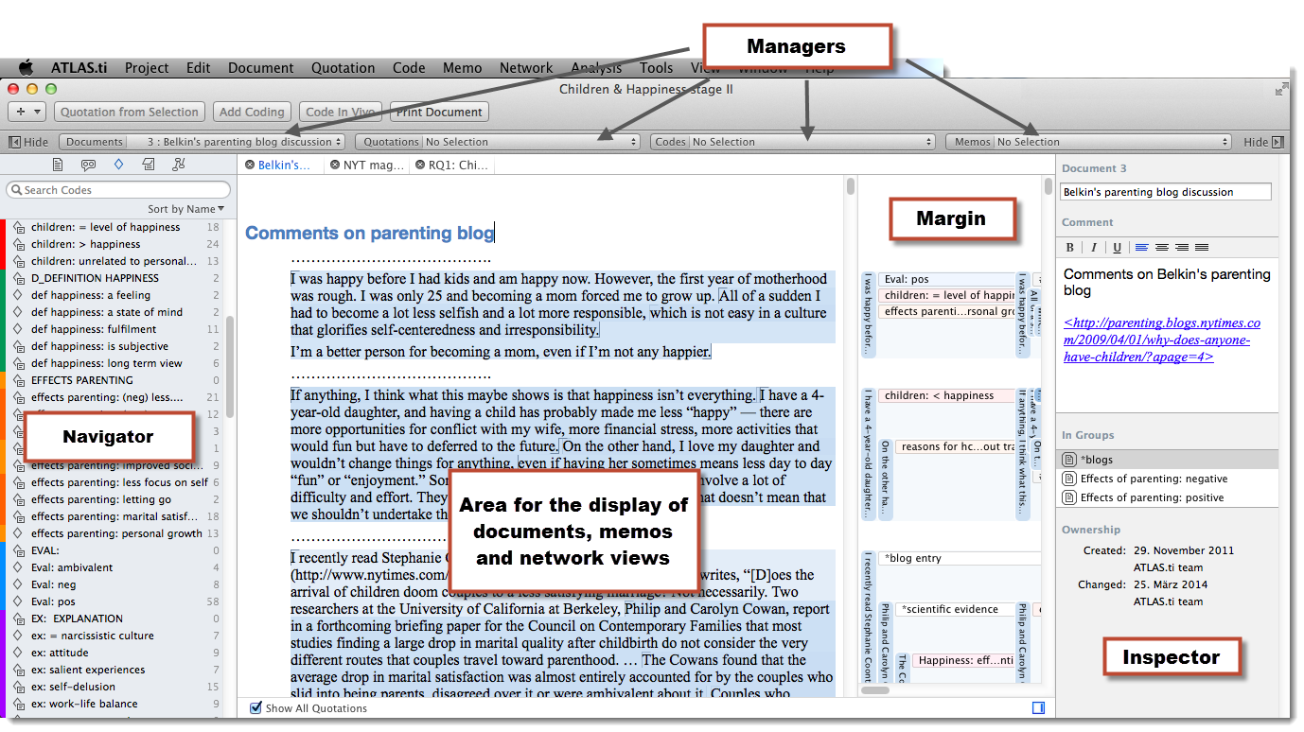
Atlas.ti

Slide 18
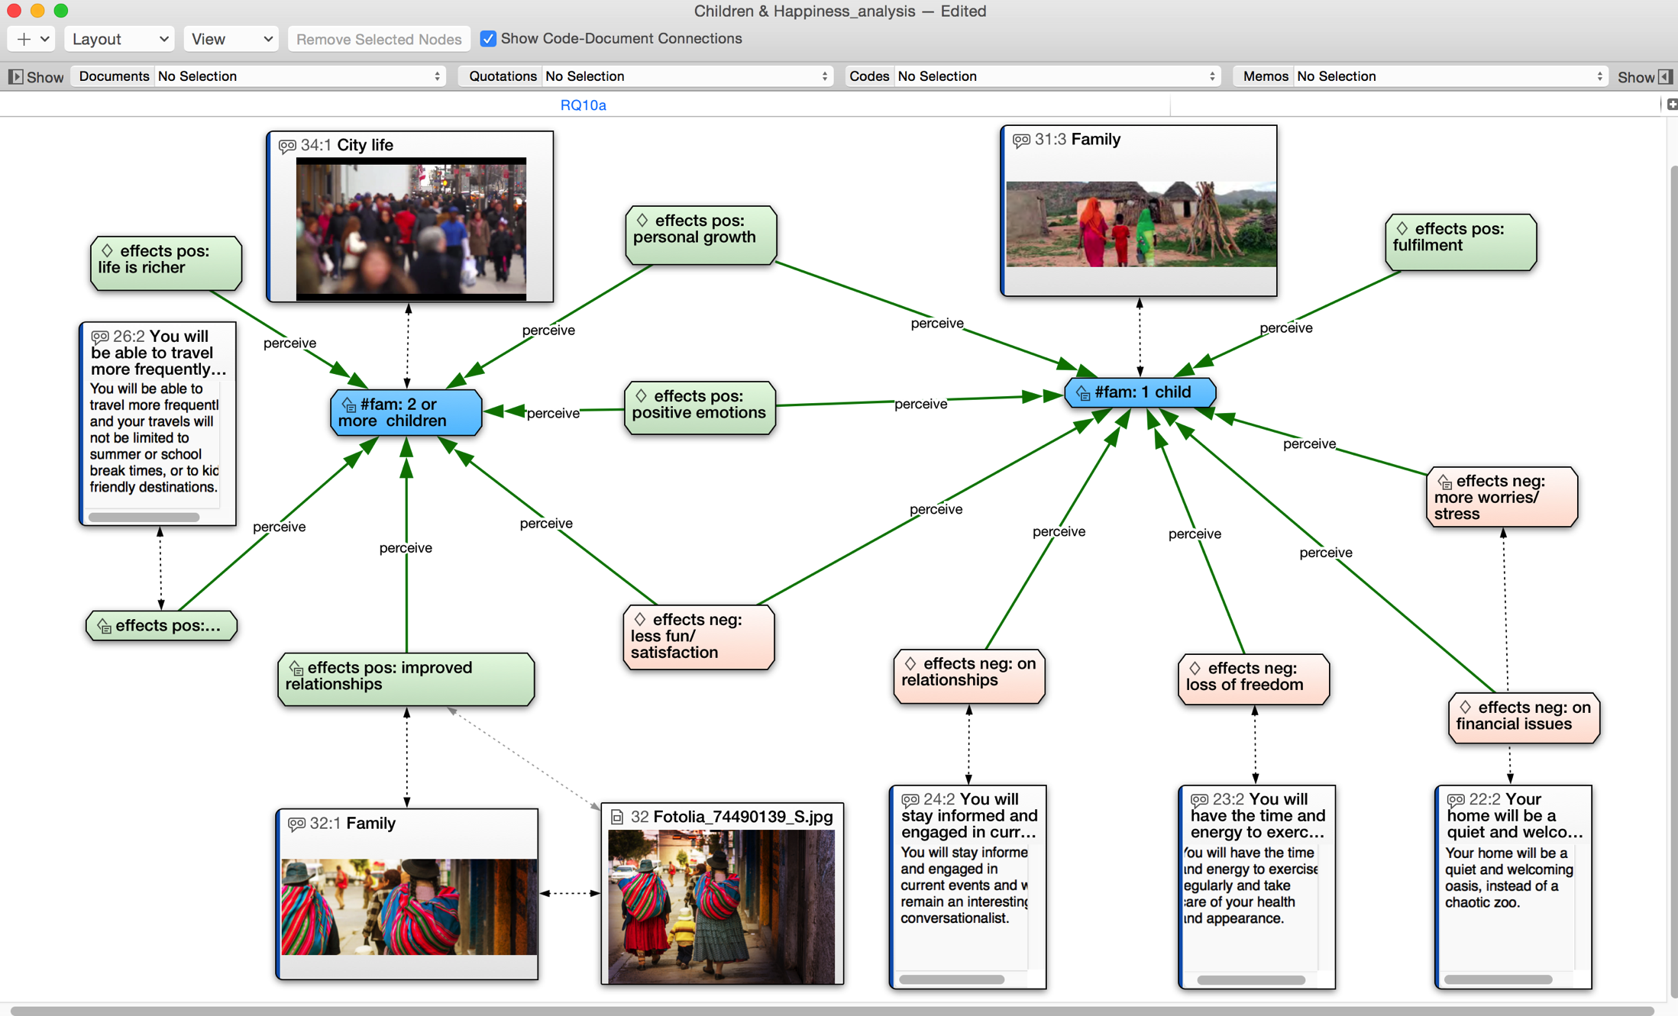
Atlas.ti
An Example of Concept Mapping in Atlas.ti

Slide 19
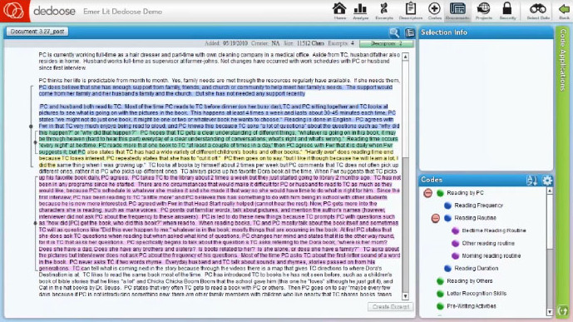
Dedoose

Slide 20
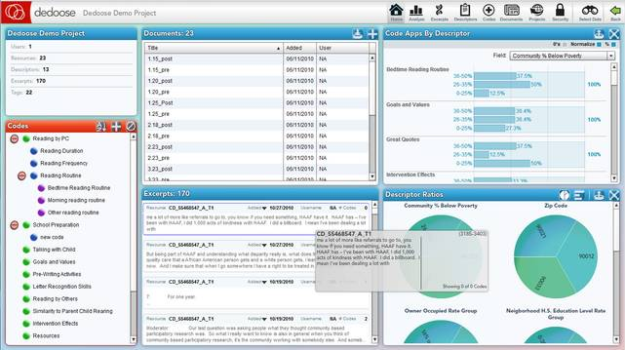
Dedoose

Slide 21
Evaluating the Quality of Qualitative Research (slide 1 of 4)
Validity
Reliability

Slide 22
Evaluating the Quality of Qualitative Research (slide 2 of 4)
Questions/Assessments for Evaluating Qualitative Research
How credible are the findings?
How has knowledge or understanding been extended by the research?
How well does the evaluation address its original aims and purpose?
How well is the scope for drawing wider inferences explained?
How clear is the basis of evaluative appraisal?
How defensible is the research design?
How well defended are the same design/target selection of cases/documents?

Slide 23
Evaluating the Quality of Qualitative Research (slide 3 of 4)
How well is the eventual sample composition and coverage described?
How well was the data collection carried out?
How well has the approach to, and formulation of, analysis been conveyed?
How well are the contexts of data sources retained and portrayed?
How well has diversity of perspective and content been explored?
How well has detail, depth, and complexity of the data been conveyed?

Slide 24
Evaluating the Quality of Qualitative Research (slide 4 of 4)
How clear are the links between data, interpretation, and conclusions?
How clear and coherent is the reporting?
How clear are the assumptions/theoretical perspectives/values that have shaped the form and output of the evaluation?
What evidence is there of attention to ethical issues?
How adequately has the research process been documented?

Slide 25
Ethics and Qualitative Data Analysis
The subjective element in qualitative data analysis provides an added challenge to avoiding bias in data interpretation.
Taking special steps to protect the privacy and identity of subjects is crucial.

Slide 26
Chapter Summary (slide 1 of 2)
Identify and explain the three methods for linking theory and analysis.
Describe the use of coding in the analysis of qualitative data.
Recognize some computer programs that can be used for qualitative analysis and explain how they work.

Slide 27
Chapter Summary (slide 2 of 2)
Provide examples of how quantitative data can be analyzed qualitatively.
Explain some of the ways researchers can assess the quality of qualitative data.
Summarize some of the ethical issues that can occur in qualitative research.

